Slide 1

Get a room!
Release 2

Slide 2
The team
Three senior developers:
Aki product - manager
Eetu - product owner
Juho - Fullstack
Four junior developers:
Severi - Frontend
Matias - Accessability, Frontend
Clarine - UI/UX
Aleksander - Frontend/backend

Slide 3
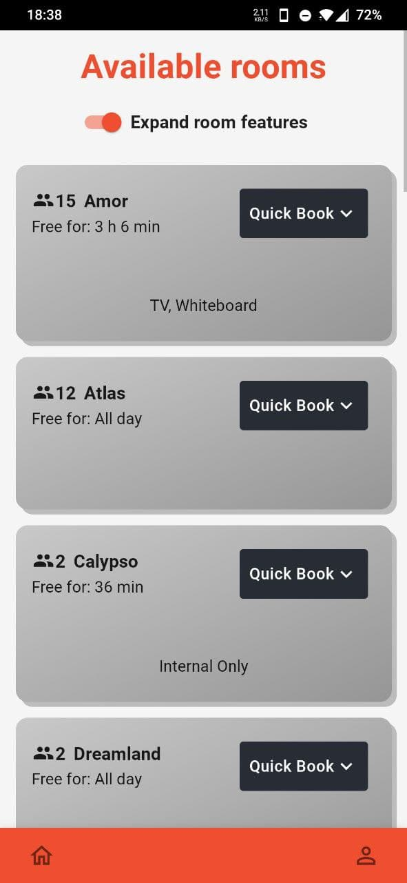
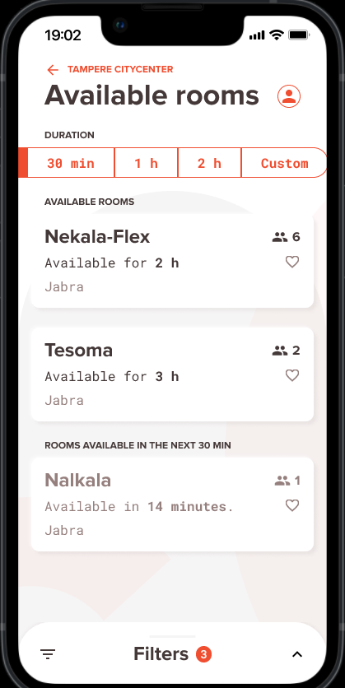
Our project
Google cloud based application for reserving meeting rooms
What is release 2?
-revisions to UI
-new features (filtering, gps etc…)
-better accessability

Slide 4
VINCIT
Software developement company from Finland
Founded in 2007
Consulting
Products
Over 500 employees

Slide 5
Communications
Team:
Weekly meetings
Communications channel discord
Customer:
Biweekly meetings
Communications through slack
Trello board for keeping track of tasks

Slide 6
Technologies
Google cloud based
Language: Typescript
Backend: NodeJs, Express
UI: React, MaterialUI
Database: MongoDB (Developement purpoises)
Testing: Jest
Version control: Github
CI/CD: Github actions
Code formatter: Eslint/Prettier

Slide 7
Management issues and risks
Some timing issues within the team, but we hope to release a great version 2 of the product to the customer.
Few main risks
New technologies for all team members
Issues with testing the product, we cannot access production version
Losing group members

